Slide 1
Applied Data Science and visualization 2024
Lecture 4 John Shorter

Slide 2
What are we going to do today?
We are going to switch gears and focus on some common statistical tests you will use during your master's research
We will learn about an ANOVA, and what assumptions we need to fulfil in order to use it
We will then learn about how to transform or analyze data when data does not meet these assumptions

Slide 3
What are we learn last time?
Plotting can be hard
LLMs like ChatGPT and Rtutor are very good at helping us with R coding
You are encouraged to use these tools in this class and for the miniproject

Slide 4
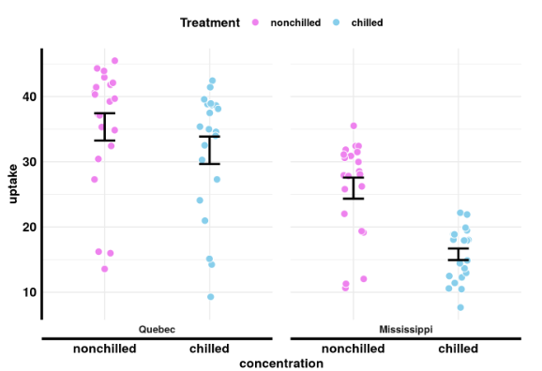
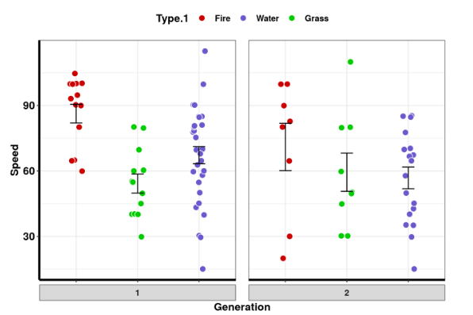
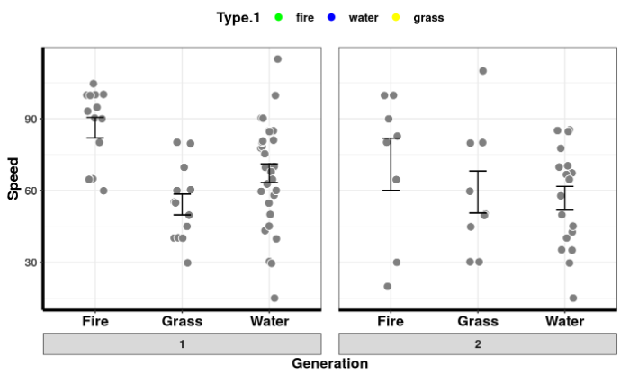
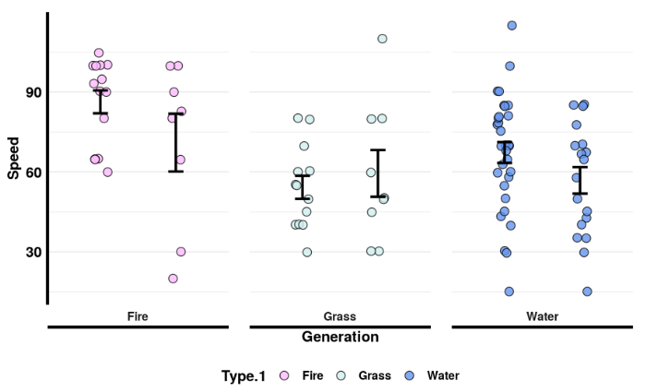
Nice examples from the last class

Slide 5
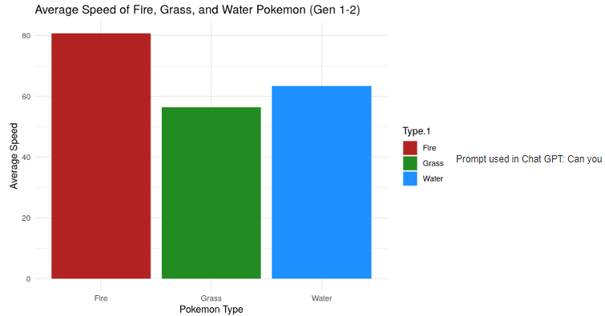
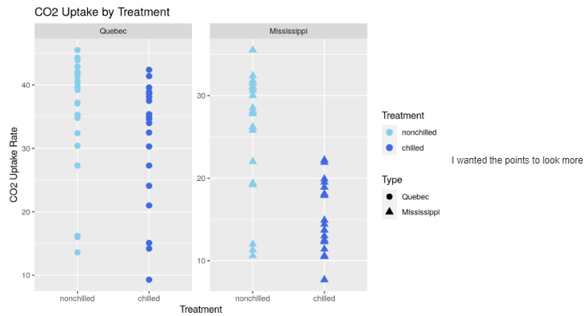
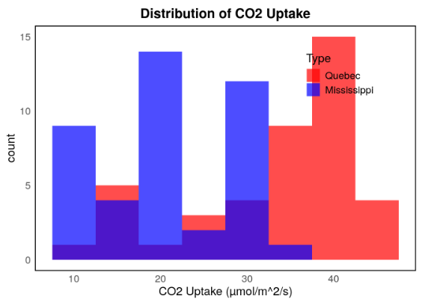
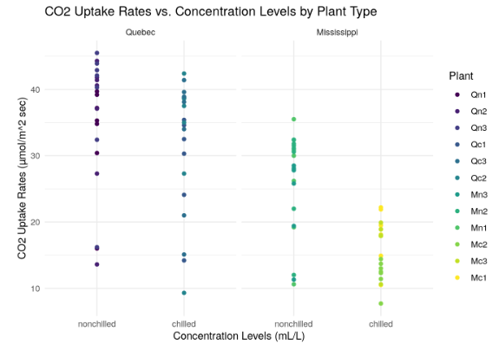
Nice examples with help from ai

Slide 6
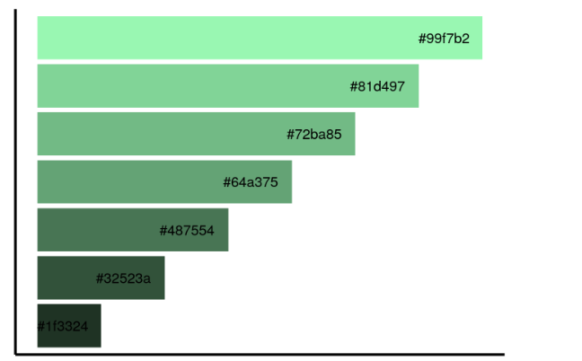
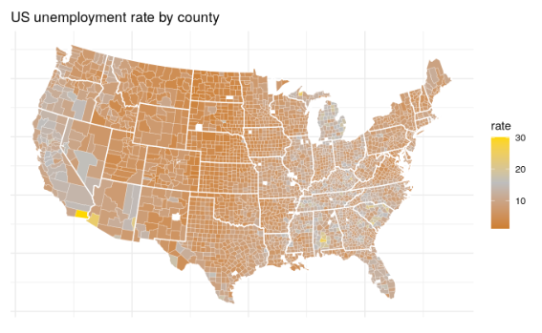
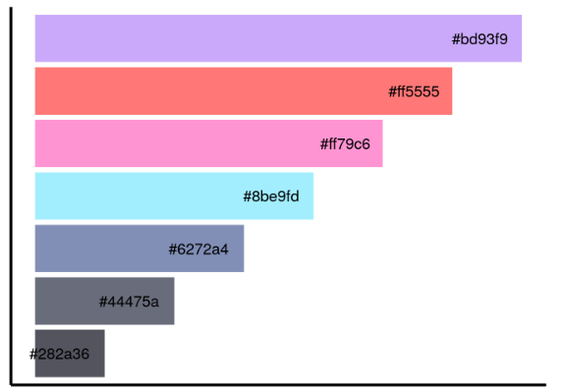
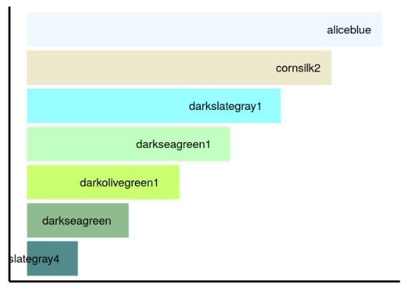
Nice color palettes

Slide 7
Let’s get started and go to ucloud

